Slide 1


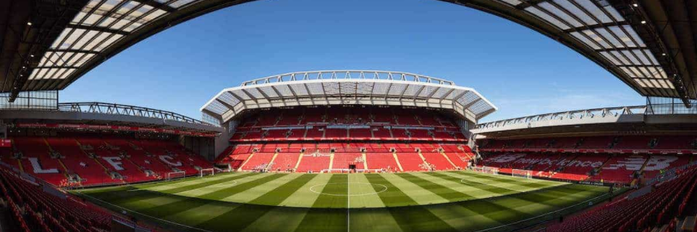
Soccer (football) game analysis
Retrieved from: https://www.thisisanfield.com/clubinfo/anfield/
Erik Stieve
Regis University

Slide 2
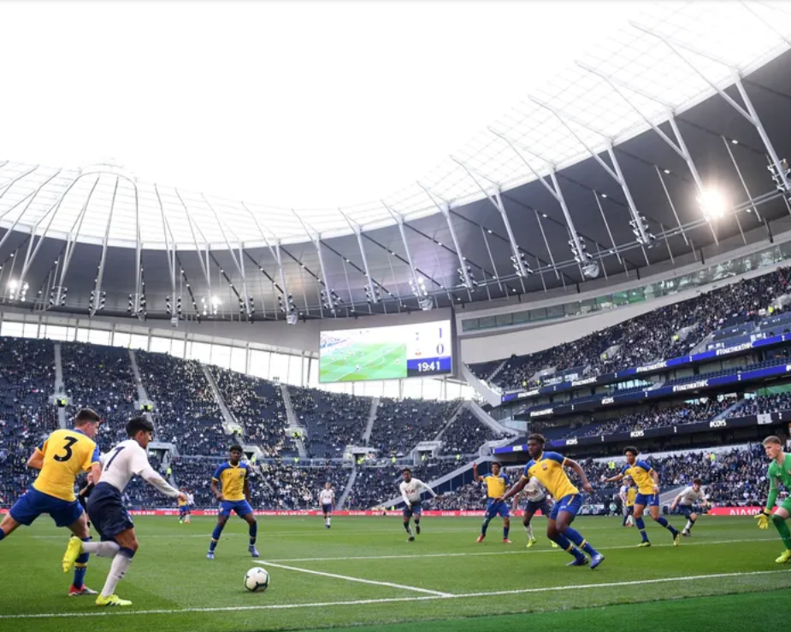
Overview
Purpose
Process
Analysis
Challenges
Conclusions
Retrieved from: https://www.premierleague.com/news/1113111

Slide 3
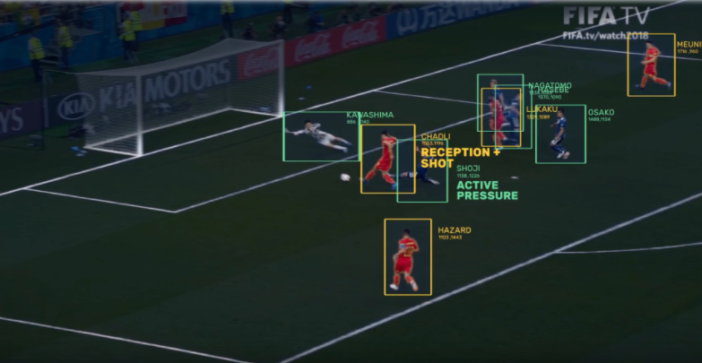
Purpose
Sports Analytics are gaining traction to assist the decision-making process
Spatio-temporal data tracking action on the field
Leverage data to analyze tactics
Predict match outcomes later in the season
Retrieved from: https://www.sportspromedia.com/opinion/ai-sports-analytics-sportlogiq-how-it-works

Slide 4
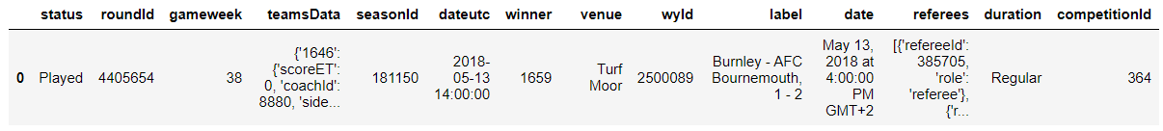
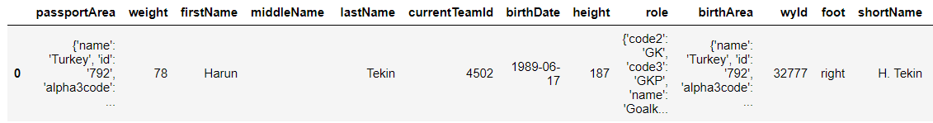
Process - Data
Events
Spatio-temporal data tracking events from matches during 2017-18 season
Stored in relational database
Retrieved as tables in JSON
Links events to:
Players
Matches
Teams
Competitions
Matches
Teams
Players
Competitions

Slide 5
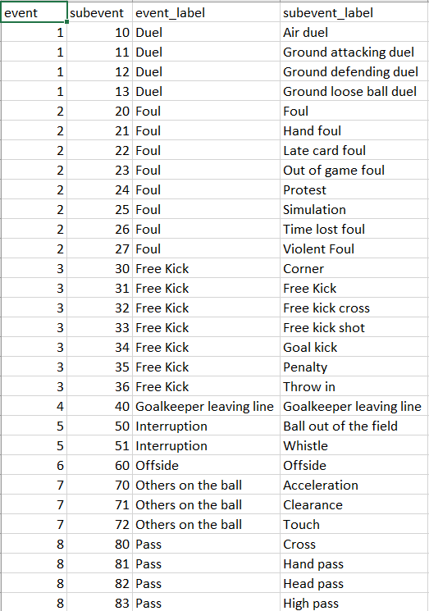
Process - Data
Events
Each event in the game has an Event code and a corresponding subevent
Actions are tagged to a player and a location

Slide 6
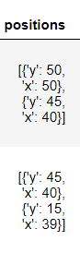
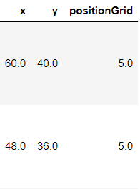
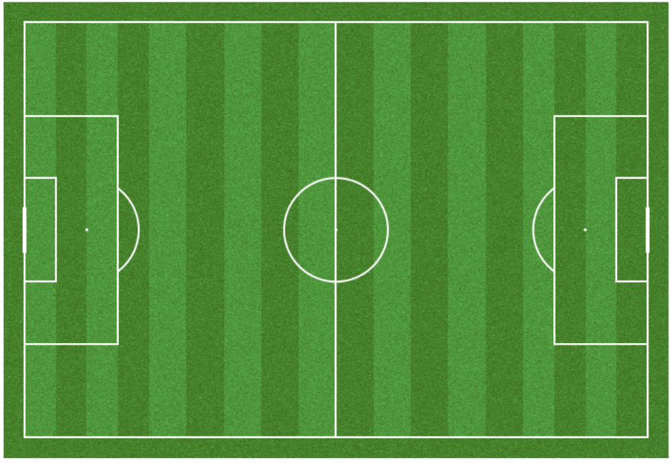
Process - Data
Link the tables together to create a single record
Extract spatial data to make useable for plotting
Remove unnecessary columns
Process the data for analytics
Positional data
Convert to coordinates
Create grids
15
11
7
3
14
10
6
2
13
9
5
1
12
8
4
0

Slide 7
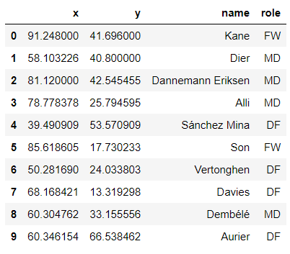
Analysis - Visualization
Visualize team tactics
Parse out single game events by team
Calculate centroid for each player

Slide 8
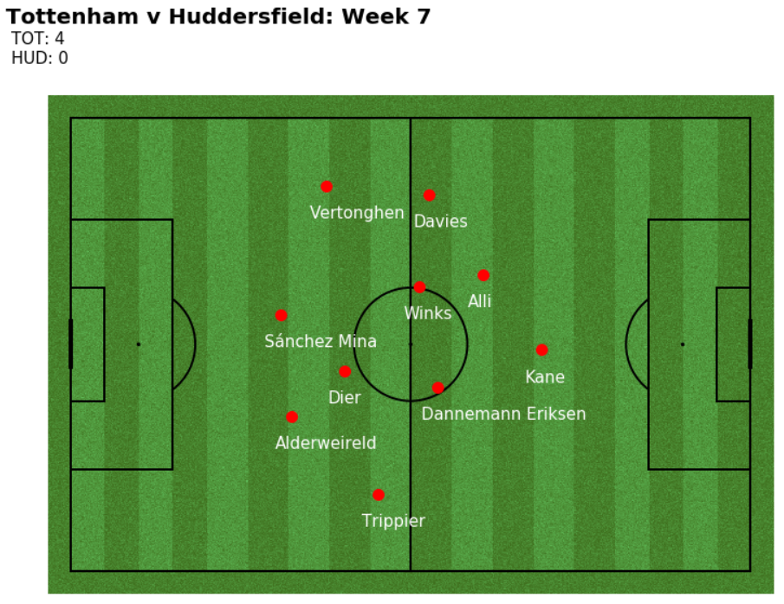
Analysis - Visualization
Display team tactics
Tottenham Hotspur games
Compare
Official formation
Tactical Assessment
Opposing team

Slide 9
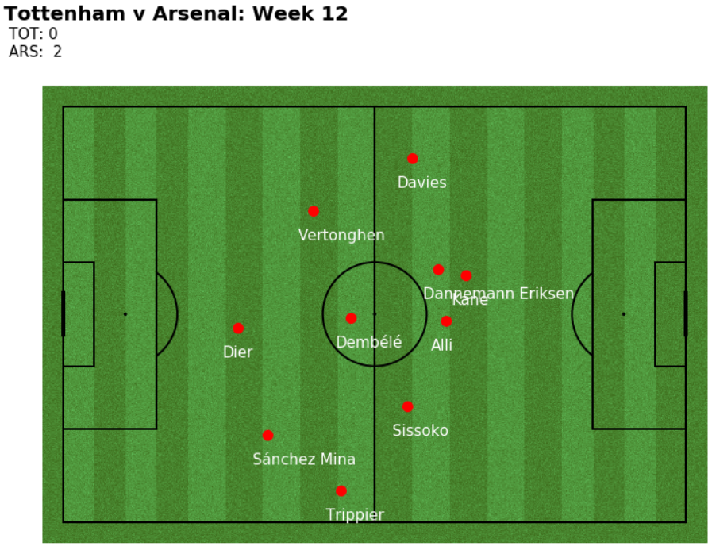
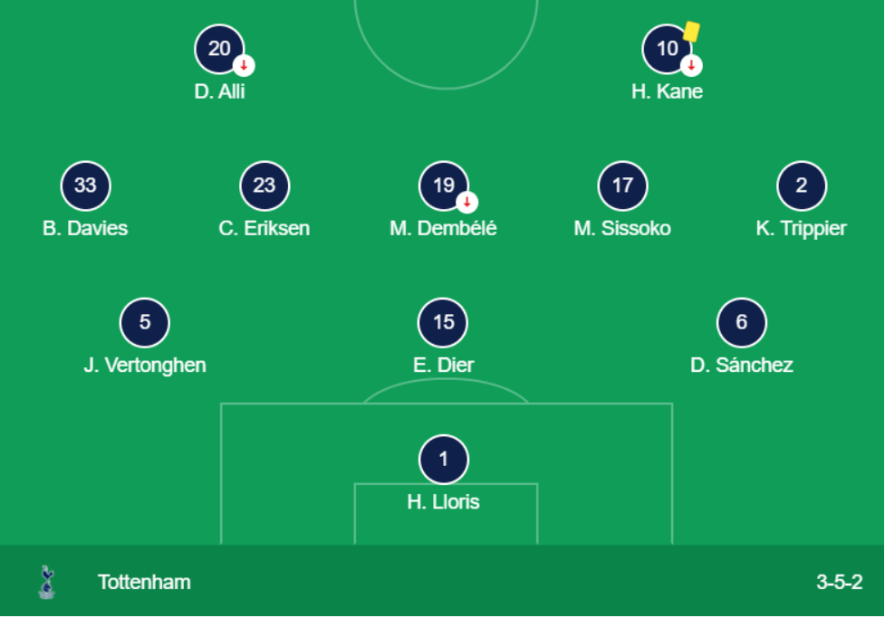
Analysis - visualization
Retrieved from: https://www.google.com/search?q=tottenham+arsenal+11%2F18%2F2017&rlz=1C1CHBD_enUS734US734&oq=tottenham+arsenal+11%2F18%2F2017&aqs=chrome..69i57j33i160.24003j1j15&sourceid=chrome&ie=UTF-8#sie=m;/g/11hcjrlyyx;2;/m/02_tc;ln;fp;1;;

Slide 10
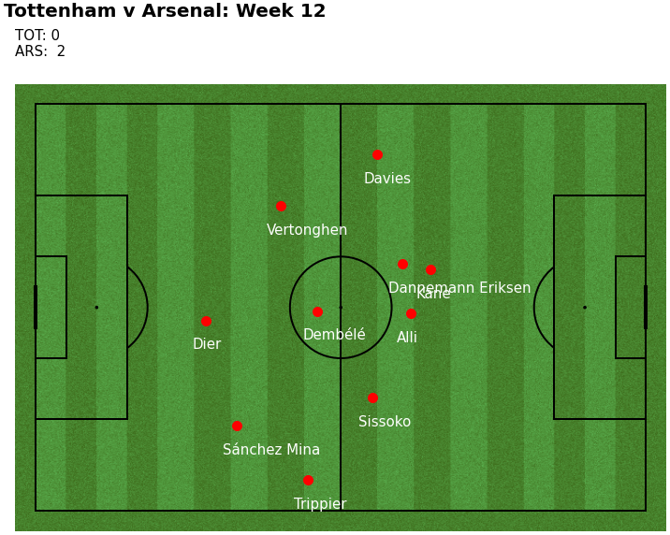
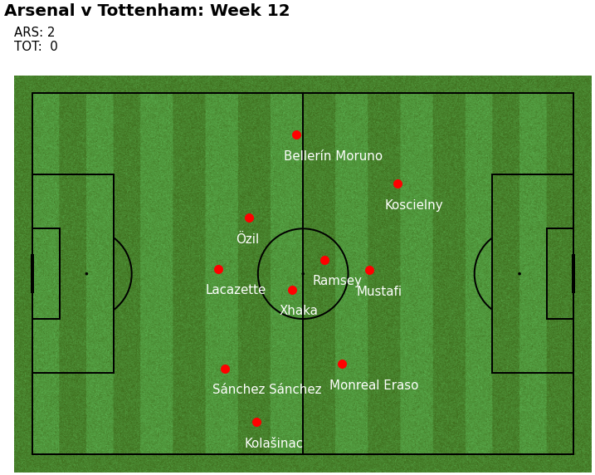
Analysis - visualization

Slide 11
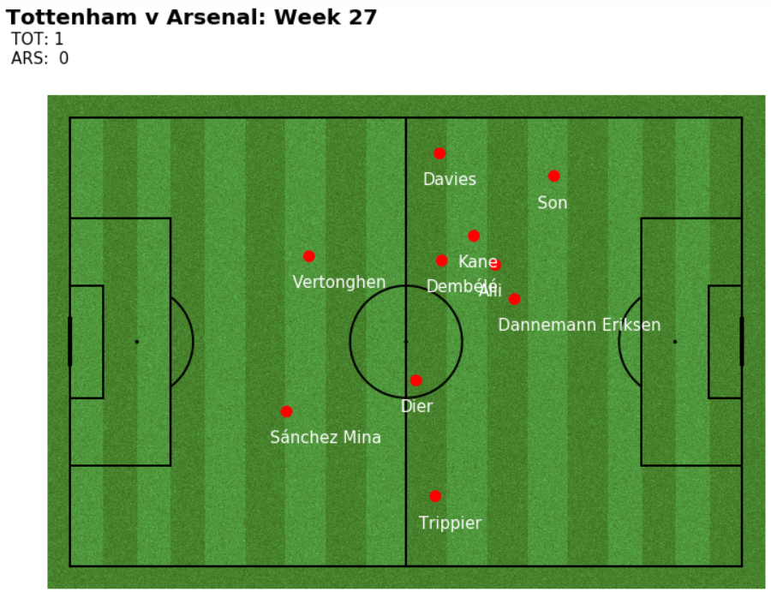
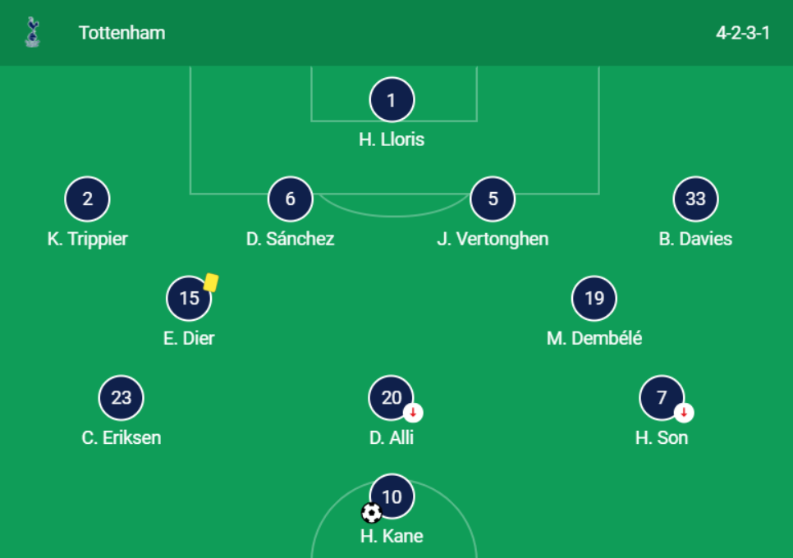
Analysis - visualization
Retrieved from: https://www.google.com/search?rlz=1C1CHBD_enUS734US734&sxsrf=ALeKk03tR9FCUgYo0uGmZAlBLeFeKk_RhQ%3A1607229247073&ei=P1_MX_WGBILdtAaN5qTIDA&q=tottenham+arsenal+2%2F10%2F2018&oq=tottenham+arsenal+2%2F10%2F2018&gs_lcp=CgZwc3ktYWIQAzIFCAAQzQI6BAgAEEc6BggAEAgQHlDVKVjiLWCBMmgAcAJ4AIABSogBjAGSAQEymAEAoAEBqgEHZ3dzLXdpesgBCMABAQ&sclient=psy-ab&ved=0ahUKEwi1ouDCw7jtAhWCLs0KHQ0zCckQ4dUDCA0&uact=5#sie=m;/g/11hcjr60xt;2;/m/02_tc;ln;fp;1;;

Slide 12
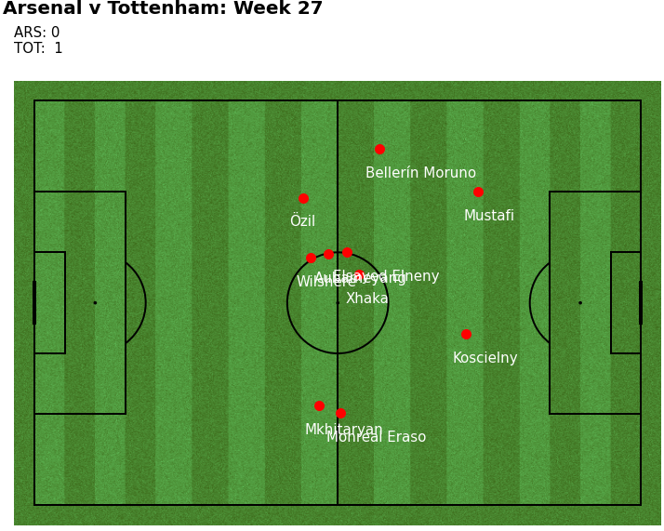
Analysis - visualization

Slide 13
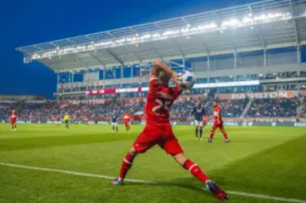
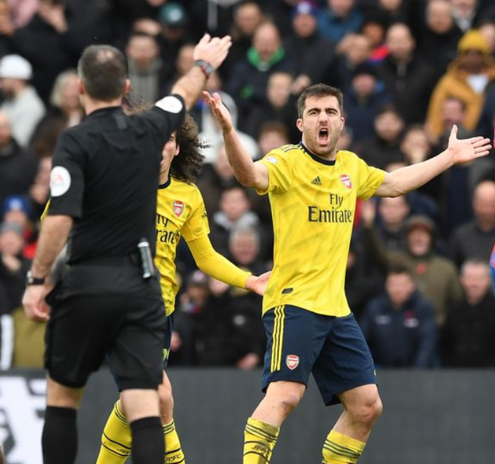
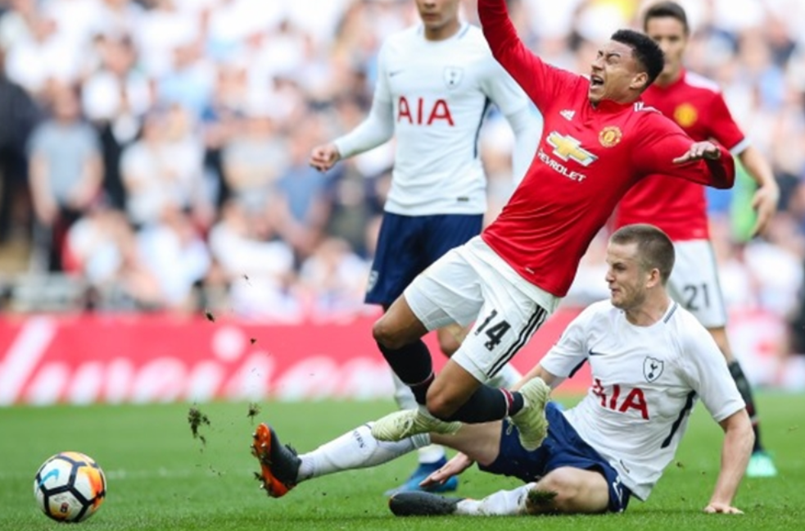
Analysis - Predictions
Predict Game outcomes
Condense events from each game into single record
Grids and events combined
Splitting the data
Drop extraneous data
Fouls
Throw-ins
Offsides
Whistles
Protests
Retrieved from: https://www.soccercoachweekly.net/newsletters/how-to-take-advantage-at-throw-ins/
Retrieved from: https://www.thefa.com/football-rules-governance/lawsandrules/laws/football-11-11/law-12---fouls-and-misconduct
Retrieved from: https://www.football.london/arsenal-fc/news/sokratis-var-aubameyang-red-card-17554375

Slide 14
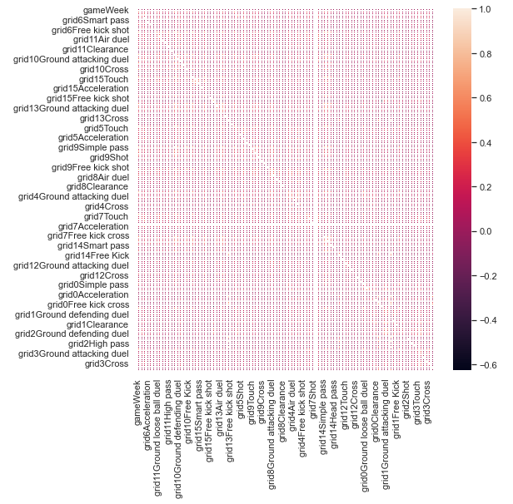
Analysis - Predictions
EDA
Correlation plot?
There are 210 fields!

Slide 15
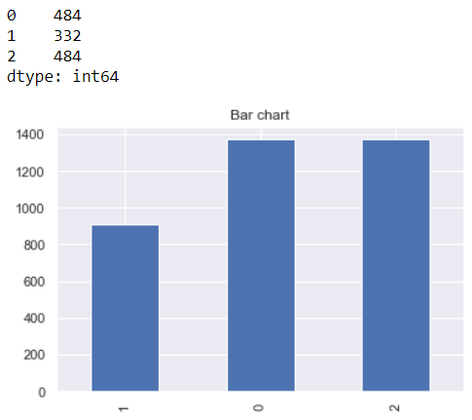
Analysis - Predictions
EDA
Predicting wins
0 = Loss
1 = Draw
2 = Win
Wins/losses are even
Draws occur for 34% of games

Slide 16

Analysis - Predictions
Models
Decision Tree
Random Forest
KNN
Neural Network
Retrieved from: https://www.forbes.com/sites/sallypercy/2019/10/09/forget-your-crystal-ball-how-can-leaders-really-prepare-for-the-future/?sh=353e55cc2122

Slide 17
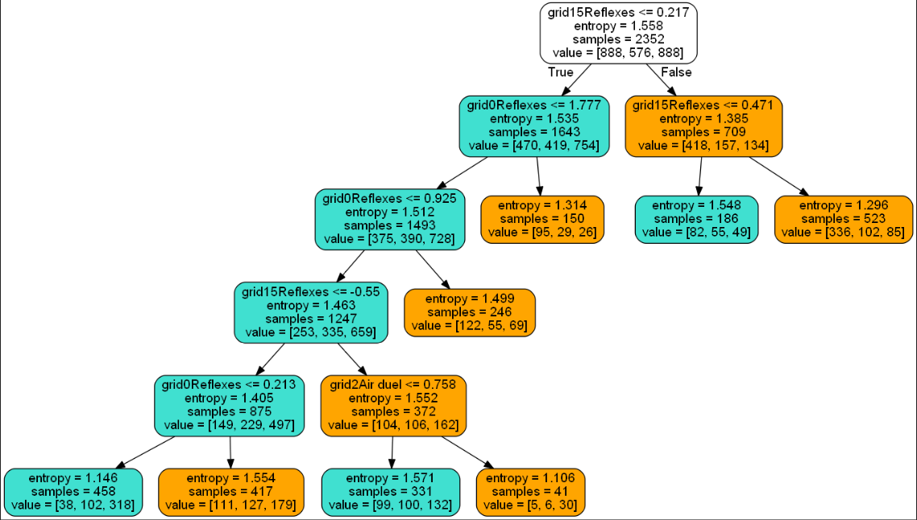
Analysis - Predictions
Model Optimization
Pruned Decision Tree
Optimal K-value
Parameter tuning utilizing grid search

Slide 18
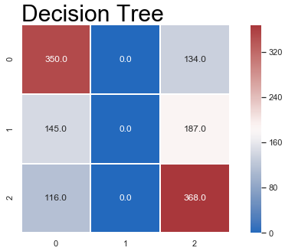
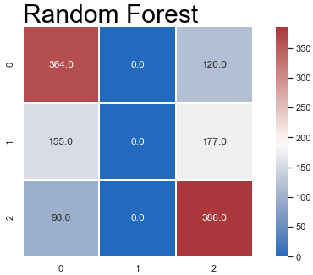
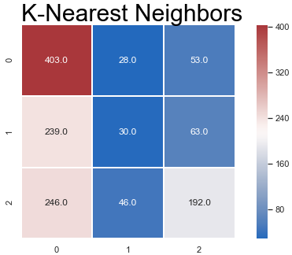
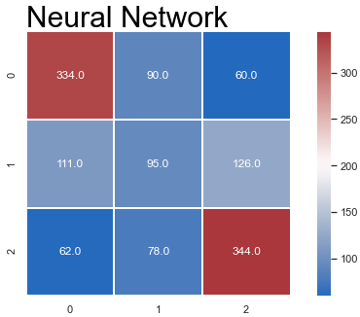
Analysis - Predictions
The Accuracy scores are similar, and the models are not doing well at predicting draws.

Slide 19
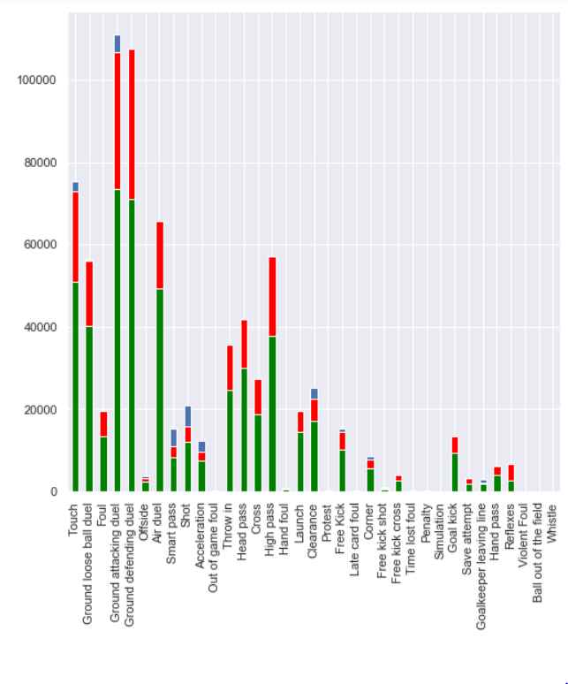
Analysis - Predictions
To draw or not to draw?
EDA will decide
Consolidated total for every unique event
Wins - Blue
Losses - Red
Ties - Green

Slide 20
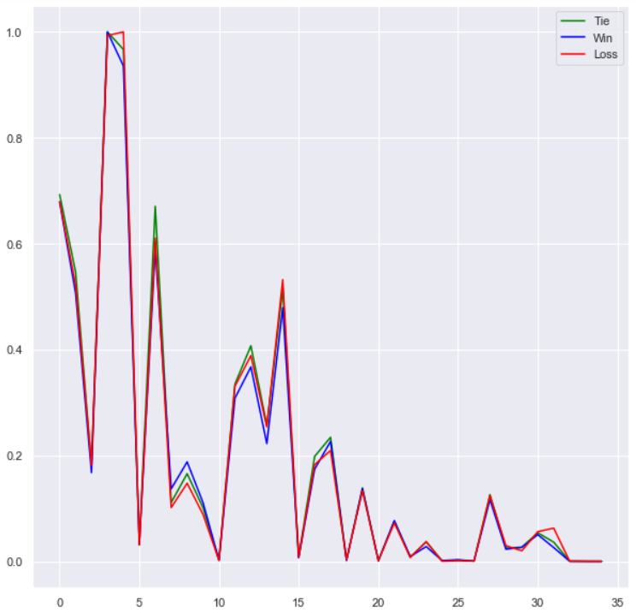
Analysis - Predictions
To tie or not to tie?
Scaled
Ties appear to be more ambiguous.
Our models may have challenges predicting ties.

Slide 21
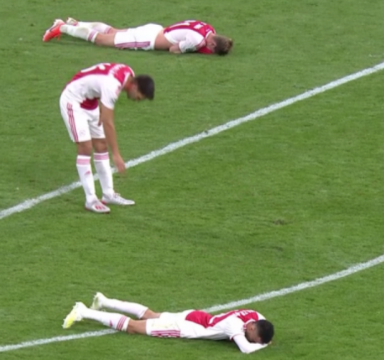
Analysis - Predictions
Draws are difficult to classify
There appears to be some ambiguity in the data when it comes to draws.
The models were categorizing draws as both wins and losses.
What if we remove the draws?
Retrieved from: https://the18.com/soccer-entertainment/ajax-reaction-to-defeat-fan-videos

Slide 22
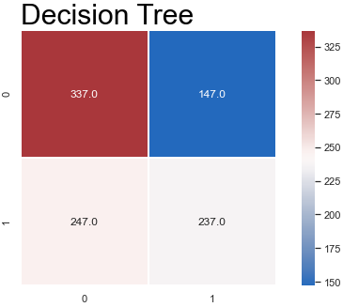
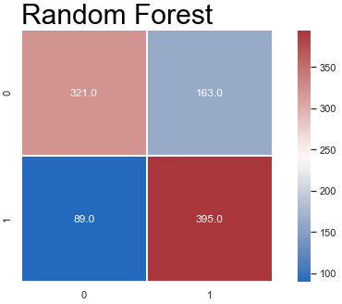
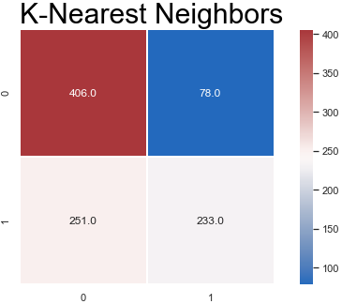
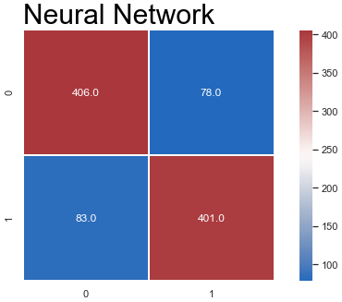
Analysis - Predictions
The accuracy scores are much better.
The neural network is our optimal model.

Slide 23
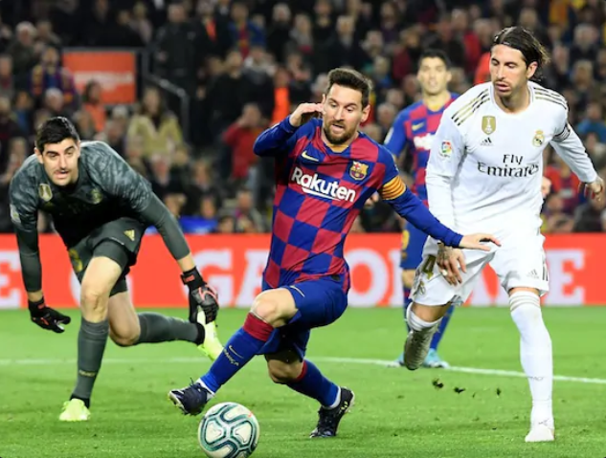
Challenges
Complex data
Optimize the spatial
Handling Draws
Advanced Metrics
Team quality
Player quality
Retrieved from: https://sports.ndtv.com/football/unfamiliar-homes-offer-barcelona-real-madrid-fresh-challenge-in-la-liga-title-race-2242525

Slide 24
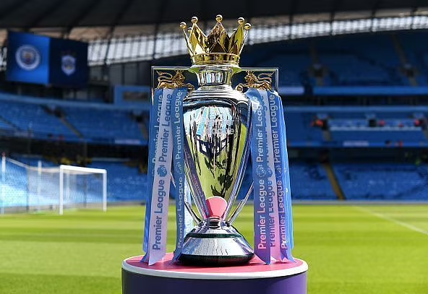
Conclusions
Good start
Predicting end of season?
Assess team progress throughout season
Further analysis
Incorporate rankings
Home field advantage?
Retrieved from: https://www.sportskeeda.com/football/premier-league-winners

Slide 25
References
Data retrieved from: https://figshare.com/collections/Soccer_match_event_dataset/4415000
Pappalardo et al., (2019) A public data set of spatio-temporal match events in soccer competitions, Nature Scientific Data 6:236, https://www.nature.com/articles/s41597-019-0247-7
Pappalardo et al. (2019) PlayeRank: Data-driven Performance Evaluation and Player Ranking in Soccer via a Machine Learning Approach. ACM Transactions on Intellingent Systems and Technologies (TIST) 10, 5, Article 59 (September 2019), 27 pages. DOI: https://doi.org/10.1145/3343172

